Slide 1
MHS Science Presentation
Ms. Deborah Sarmir, Mr. Paul Popadiuk,
Mr. Jason Sullivan and Mr. Ron Zalika
12/16/2014

Slide 2
WHY ARE WE HERE?
Philosophical Approach
Pragmatic Approach

Slide 3
An Outline of Tonight’s Presentation:
An Overview of our Science Program
Why Physics First?
What does instruction look like in the Physics classroom?
Highlight new aspects of the physics program being implemented in 2014-2015

Slide 4
NJ State Requirements
NJ HIGH SCHOOL
GRADUATION REQUIREMENTS
Science | 15 credits · 5 credits in laboratory Biology/Life Science or the content equivalent · Lab Chemistry and/or Physics and/or Environmental Science · One additional laboratory/inquiry-based science course

Slide 5
The Traditional HS
Science Course Sequence
Grade 9
Biology
or
Environmental Science
Grade 10
Biology
or
Chemistry
Grade 11
Chemistry
or
Physics
or
Environmental Science
Grade 12
No Science
or
Science Elective
or
Physics
or
Environmental Science
Originated in 1894!

Slide 6
The MHS Science
Course Sequence (since ‘02)
Grade 9
Physics
Grade 10
Chemistry
or
AP Chemistry
Grade 11
Biology
or
AP Biology
or
iSTEM
Grade 12
iSTEM
or
Environmental Science
or
AP Science
100% of MHS students take Physics

Slide 7
Why Physics First...or rather…
Why Biology Last?
The Future of STEM in the U.S
% of BAs in STEM Fields
“We are not producing, in this country, in America, enough young people going into science, technology, and engineering - the fields that are going to be essential for entrepreneurship and innovation in the 21st Century”
-- Thomas Friedman, The World is Flat

Slide 8
Why Physics First...or rather…
Why Biology Last?
The Ghost of Physics Past
Laying the Intellectual Foundation
Physics and Math
What about other districts?
Never-ending Curricular Work

Slide 9
MHS Science Program History
2001-2002
Course Revision (half year classes)
2002-2003
First year of 9th grade full-year physics
2004-2005
Modeling Instruction Introduced
Central Jersey Modeling Institutes
Physics (2009,2010)
Chemistry (2010,2011)

Slide 10
MHS Science Program Growth
Year | MHS Population
2002-03 | 911
2007-08 | 1675
2012-13 | 1740
2014-15 | 1715

Slide 11
MHS Science Program Growth
Year | MHS Population | AP Enrollment
2002-03 | 911 | 66
2007-08 | 1675 | 190
2012-13 | 1740 | 436
2014-15 | 1715 | 443

Slide 12
MHS Science Program
vs. Other Districts
Comparisons AP Science Enrollment 2012-13
School | Total Enrollment | # of Students Taking AP Science | Percent of AP Science
MONTGOMERY | 1740 | 436 | 25.1%
Hunterdon Central | 2946 | 249 | 8.4%
Bridgewater-Raritan | 2794 | 328 | 11.7%
Princeton | 1445 | 146 | 10.1%
WWP-S | 1599 | 178 | 11.1%
WWP-N | 1610 | 207 | 12.9%
Hopewell | 1209 | 115 | 9.5%
Milburn | 1522 | 137 | 9.0%

Slide 13
MHS Science Program Sequence
Physics - 4 levels
Chemistry - 4 levels
Biology - 4 levels
Environmental Science - 2 levels
iSTEM (63) - 1 level
Levels
General College Prep
Honors AP

Slide 14
What is Science Instruction?
there are “those who see what they believe and those who believe what they see.”
Owen H. Wangensteen
“Science is a way of thinking much more than it is a body of knowledge.” Carl Sagan

Slide 15
An Introduction to Modeling
WNET News Article on Modeling Instruction
In this video Seth Guiñals-Kupperman, a Physics teacher in the High School for Math, Science and Engineering in NY, explains how he uses Modeling Instruction to make the course content more coherent and meaningful for his students.

Slide 16
Physics First & Modeling Instruction
•Construct and use scientific models
•Use multiple representations to construct scientific model.
•Small set of core content models enhancing coherence within and among courses
•Build models through evidenced-based claims
•Modeling as the procedural core of scientific & mathematical knowledge

Slide 17
MHS Constructivist vs. Traditional
cooperative inquiry vs lecture/demonstration
student-centered vs teacher-centered
active engagement vs passive reception
student activity vs teacher demonstration
student articulation vs teacher presentation
evidence based labs vs textbook information
conceptual vs mathematical

Slide 18
Models vs Problems
The problem with problem-solving
Students come to see problems and their answers as the units of knowledge.
Students fail to see common elements in novel problems.
“But we never did a problem like this!”
Models as basic units of knowledge
A few basic models are used again and again with only minor modifications.
Students identify or create a model and make inferences from the model to produce a solution.

Slide 19
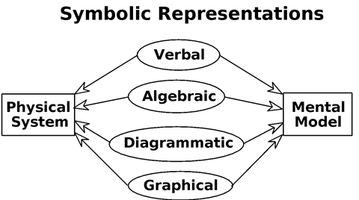
What Do We Mean by Model?
with explicit statements of the relationships between these representations

Slide 20
Models vs Problems

Slide 21
Parent-Student-Teacher Communication
Six Parent Forums Hosted: Spring 2014
UMS PTA Sponsored Modeling Workshop
February 19th , 2015
6:30-8:00PM in UMS Media Center
Student Advisory Group - 8th Gr. Transition
Student STEM Board
24/7 Access to Genesis Gradebooks
Digital Resources & email blasts

Slide 22
Shared Resources
Science Department Website
After School Assistance
Tuesday, Wednesday and Thursday
Study Hall
Small Group Sessions
S.O.A.R. summer preview courses
MHS Guidance

Slide 23
Ongoing Professional
Collaboration and Training
How Students Learn in the Science Classroom.
Next Generation Science Standards
The vision represented in the Framework is new in that students must be engaged at the nexus of the three dimensions:
1. Science and Engineering Practices,
2. Crosscutting Concepts, and
3. Disciplinary Core Ideas.

Slide 24
Ongoing Professional
Collaboration and Training
University/ College Partnerships
Princeton University
Rider University
Raritan Valley Community College
Arizona State University
Rutgers University
Columbia University - Teachers’ College
Professional Organizations
American Modeling Teachers’ Association
American Association of Physics Teachers
STEMTeachersNYC

Slide 25
Building a Common Experience
Enhancing consistency
Establishment of Collaborative Learning Teams
Development of common assessments
Sharing of instructional strategies
Analyzing areas of strength and weakness
Regular conversations are happening
Progress being assessed

Slide 26
Assessment
Increasing quantity of assessments in physics
Necessary transition from 2 assessments/ marking period
Teachers have increased both the number of assessments and types of assessments
Continue working on developing quality assessments that demonstrate student mastery of physics content
This increase aligns with our SEL goals

Slide 27
Ongoing Professional Collaboration and Training
S.O.A.R. Course Previews: HS Team Teaching
Mastering the art of modeling instruction
S.O.A.R. Responsive Teaching in Science Workshop and Student Course
Exploring the benefits of modeling instruction to engage learner in grades 2-8

Slide 28
Positive Points
Students getting into great schools
Student Advisory expressed positive changes in Physics this year
Students engaged in science co-curriculars
Pre/Post assessment data are incredible
AP Physics scores are outstanding

Slide 29
MHS Science-related
Extra-Curricular Clubs
Opportunities (400 students)
-Science League -Science Olympiad
-MSEA -Academic League
-Science Bowl - Engineering Club
-Volunteer Science Club -Inventeam
-iGEM -Doctors of Tomorrow
-Technology Student Association -Earthwatchers
-Red Cross Club -STEM Board
-Gamers’ Guild - American Chemical Society
-Physics Olympiad -Chemistry Olympiad
-Princeton Physics Competition -Biology Olympiad

Slide 30
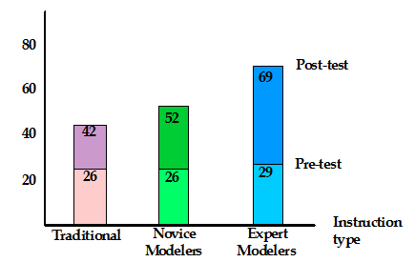
Nationally Normed Diagnostic Assessment Gains

Slide 31
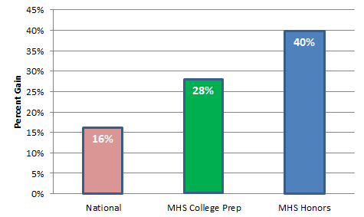
Nationally Normed Diagnostic Assessment Gains 2013-14

Slide 32
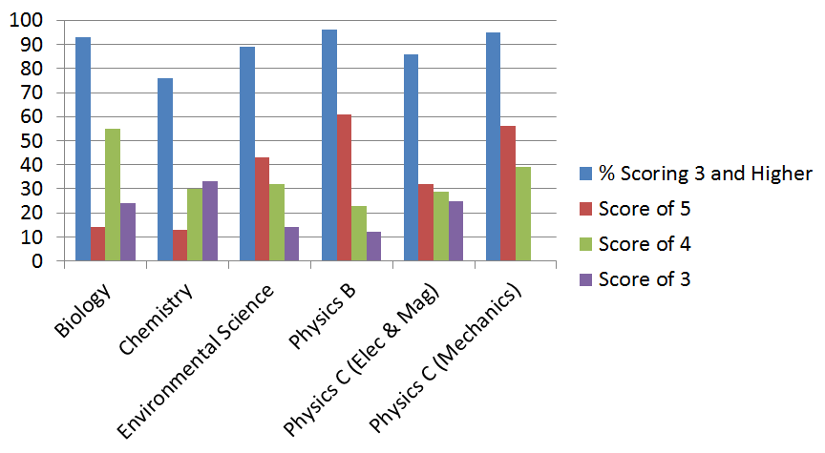
MHS Science AP Scores 2014
Compare MHS to National Averages

Slide 33
Looking Ahead
We are doing well and will continue evaluating and making improvements
Continued work on:
Communication
Assessments
Instructional strategies
Shared resources
Increased Collaboration:
Teacher to teacher
Teacher to Dept., Bldg., and Central Office Admin.

Slide 34
The Future of MHS Science Program

Slide 35
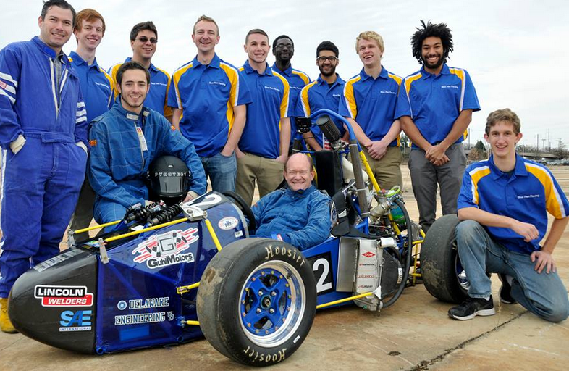
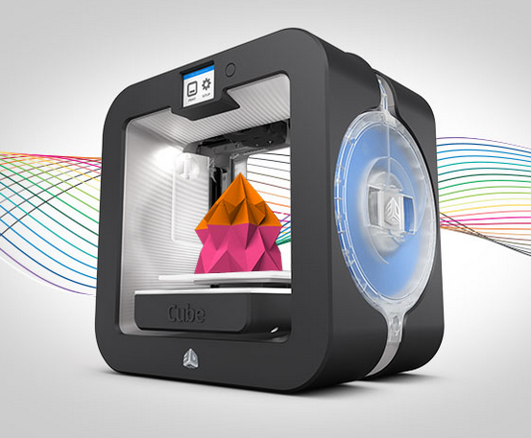
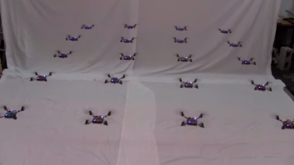
Next Steps

