Slide 1
Human Resources Proposed Personnel Adjustments 2015-2016
February 24, 2015
Kelly M. Mattis
Director of Human Resources

Slide 2
District Goals
GOAL 1:
To develop specific communication protocols with parents, staff and community members that are consistent in message and reflect the vision of the district to engage each child in reaching his/her fullest potential.
GOAL 2:
To review, evaluate and assess current programs and staffing structures to determine gaps/needs; make specific recommendations to the Board to address in a fiscally responsible and efficient manner in the following areas: special education, student/staff attendance and the organizational management structure of the district.

Slide 3
District Goals
GOAL 3:
To identify and implement social-emotional programming appropriate for all schools by June 2015 and identify the appropriate assessments to measure the efficacy of the programs.
GOAL 4:
To explore the feasibility of full day kindergarten for the 2016-2017 school year.

Slide 4
Policy 2312—Class Size
Grade Level
K-2
Grades 3-8
Grades 9-12 General
Grades 9-12 Science
Grades 9-12 English
Literacy Support
Class Size Averages*
20-22
23-25
23-27
24
22
10
*outlined in Regulation 2312

Slide 5
Proposed Reallocation of Staff
Personnel to Support Approved Courses and Maintain Appropriate Class Sizes
2 OHES Teachers
1 UMS Health/PE Teacher
3 UMS Teachers-College and Career Readiness and Active Citizenship
1 UMS Web Design and Coding Teacher
1 UMS Music Technology Teacher
All (8) positions reallocated from existing staff. No additional costs.

Slide 6
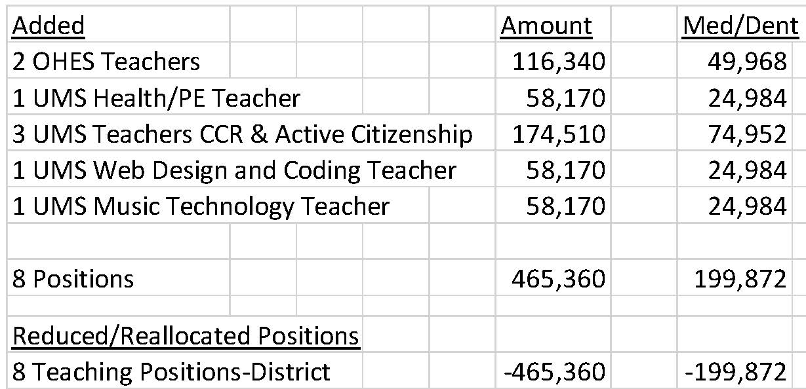
2015-2016 Personnel Adjustments
REALLOCATED PERSONNEL

Slide 7
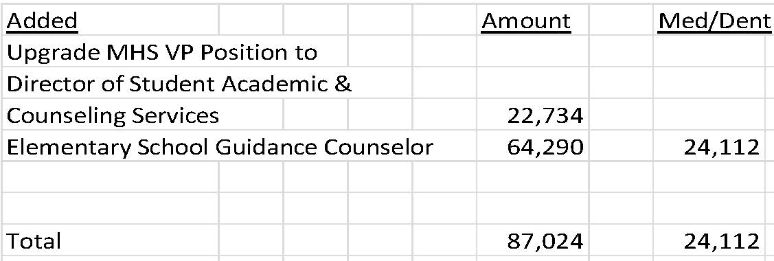
2015-2016 Personnel Adjustments
PERSONNEL ADDITIONS

Slide 8
Required Personnel Additions
ORCHARD ELEMENTARY SCHOOL
1 In-Class Support Teacher
3 Personal Teacher Instructional Aides
1 English Language Learner Teacher (ELL)
VILLAGE ELEMENTARY SCHOOL
1 In-Class Support Teacher

Slide 9
Required Personnel Additions
LOWER MIDDLE SCHOOL
2 In-Class Support Teachers
1 Teacher Instructional Aide
HIGH SCHOOL
.4 English Language Learner Teacher (ELL)
.08 Speech Teacher
.6 Transition Coordinator

Slide 10
Personnel Adjustments Special Education & ELL
PERSONNEL ADDITIONS

Slide 11
Co-Curricular Recommendations
New Coaching and Advisor Positions
MHS -$4,600
Junior Varsity Volleyball Program
Program succession plan-entering 4th year of takeover plan
Participation-14 girls
LMS- $1,540
Math/Science Club Advisor Grade 5
Participation-projected interest of 70-100 students
Notes:
Volleyball numbers similar to assistant swimming, practice 6 days/week

Slide 12
Total Personnel Budget Projection Fund Summary
2014-2015 = $62,567,665
2015-2016 = $64,478,285
Difference:$1,910,620 increase (3.05%)

