Slide 1
Demographic Study for the Montgomery Township School DIStrict
February 10, 2015

Slide 2
Statistical Forecasting
Provide demographic services for school districts in the New York-New Jersey metropolitan area.
Performed demographic studies for approximately 100 school districts in NY & NJ.
Demographic consultant for the NYC Public Schools since 2006.

Slide 3
Richard s. grip ed.d.
Executive Director
Doctorate from Rutgers University Graduate School of Education in Educational Statistics and Measurement
Numerous publications on school demography and presentations nationally
Testified as an expert witness in school demography in several Administrative Law court hearings.

Slide 4
Purpose of the Study
Project grade-by-grade enrollments from 2015-16 through 2019-20
Analyze district historical enrollments, birth and fertility rates, community population trends and age structure
Impact of new developments on enrollment
Project enrollments for existing half-day kindergarten program as well as expanding to full-day

Slide 5
Montgomery Township and Rocky hill Historical and Projected Populations 1940-2040

Slide 6
Montgomery Township Demographic Profile
67.7% White, 25.6% Asian, 2.8% Black, 4.6% Hispanic (84.6% White in 2000)
30.8% of population is under 18
Median age = 40.8 years
23% of population is foreign-born (NJ=21%). India is largest source, representing 34.5% of foreign-born pop.
Bachelor’s Degree or Higher = 76.0%
Median family income = $165,313
7,902 housing units, of which 88.4% are 1-unit homes (attached or detached)
Nearly 20% of housing units are renter-occupied.
Median value of owner-occupied unit = $591,100

Slide 7
Borough of Rocky hill Demographic Profile
91.6% White, 3.1% Two or more races
23.2% of population is under 18
Median age = 45.9 years
8% of population is foreign-born. NJ=21%.
Bachelor’s Degree or Higher = 65.9%
Median family income = $115,000
292 housing units, of which 84.5% are 1-unit homes (attached or detached)
20.4% of housing units are renter-occupied.
Median value of owner-occupied unit = $443,300

Slide 8
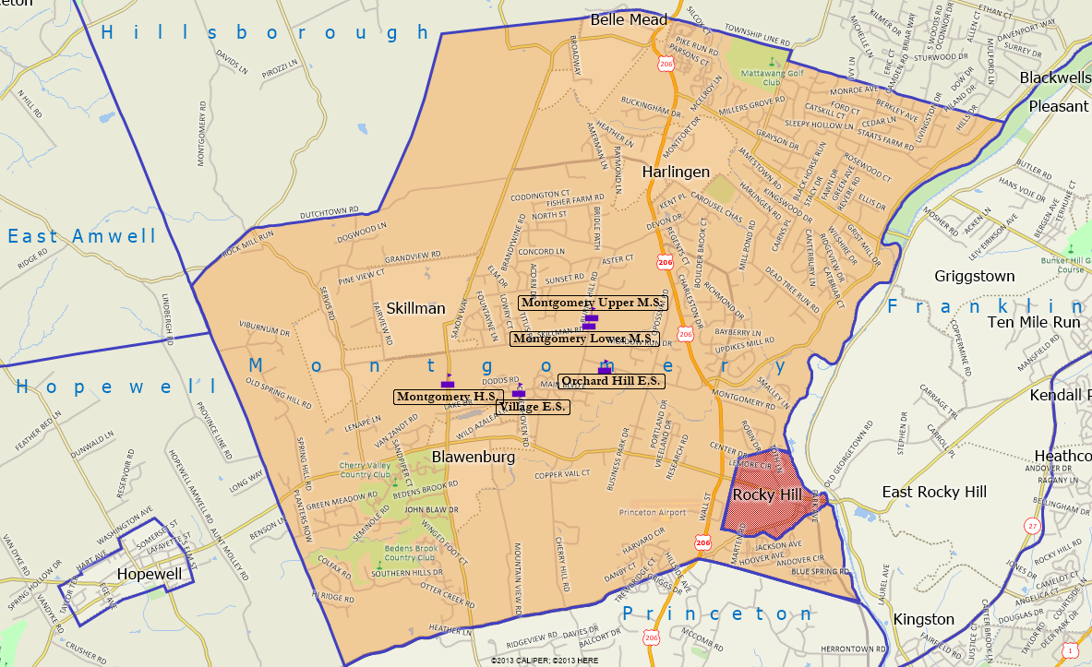
School locations

Slide 9
Historical enrollment trends
District’s October 2014 enrollment was 4,752.
Enrollment peaked in 2008-09 with 5,305.5 students and has declined for 6 consecutive years.
Loss of 362 students since 2005-06.
Cohort-Survival Ratio Method (CSR) was used to project enrollment five years into the future.

Slide 10
Historical Enrollment 2005-06 to 2014-15

Slide 11
Historical Enrollment by Level
 | PK-2 | 3-4 | 5-6 | 7-8 | 9-12
2005-06 | 1,103 | 821 | 835 | 830 | 1,525
2014-15 | 824 | 647 | 747 | 820 | 1,714
Change | -279 | -174 | -88 | -10 | +189
Peak Year | 2005-06 | 2006-07 | 2007-08 | 2010-11 | 2012-13

Slide 12
Private and parochial enrollment 2009-10 to 2014-15

Slide 13
Enrollment Projection Method Cohort Survival Ratio
Ratios are calculated for each grade progression. (Ex. 100 1st graders in 2013-14 become 95 2nd graders in 2014-15 = 0.95)
Survival ratios were computed for ten historical years. Nine of 13 average ratios were above 1.000. Ratios below 1.000 were at HS.
Averages were then computed and used to project future enrollments.

Slide 14
First grade replacement
Negative first grade replacement (FGR) has occurred for past 7 years, ranging from 79-176.5 students per year.
Negative FGR- Number of graduating 12th grade students is greater than the number of 1st grade students replacing them in the next year.
Negative FGR was 141.5 students in 2014-15, as 399.5 12th graders graduated in 2013-14 and were replaced by 258 1st graders in 2014-15.

Slide 15
Historical first grade Replacement

Slide 16
Total Enrollment change vs. First grade replacement

Slide 17
Births
Births in Montgomery have been declining: 269 in 2003, 149 in 2011.
Rocky Hill births range from 2-10 per year.
Births are used to project kindergarten students 5 years later.

Slide 18
Birth Rates and Birth-to-Kindergarten Survival Ratios
Birth Year | Births Montgomery Township | Births Rocky Hill Borough | Total Number of Births | Kindergarten Students Five Years Later | Birth-to-Kindergarten Survival Ratio
2000 | 249 | 6 | 255 | 285 | 1.1176
2001 | 251 | 9 | 260 | 302 | 1.1615
2002 | 262 | 8 | 270 | 252 | 0.9333
2003 | 269 | 8 | 277 | 293 | 1.0578
2004 | 245 | 10 | 255 | 243 | 0.9529
2005 | 226 | 7 | 233 | 237 | 1.0172
2006 | 206 | 8 | 214 | 220 | 1.0280
2007 | 189 | 7 | 196 | 202 | 1.0306
2008 | 187 | 6 | 193 | 212 | 1.0984
2009 | 160 | 7 | 167 | 246 | 1.4731
2010 | 150 | 4 | 154 | N/A | N/A
2011 | 149 | 2 | 151 | N/A | N/A

Slide 19
Historical Births 2000-2011

Slide 20
Age Pyramid Montgomery Township 2000

Slide 21
Age Pyramid Montgomery Township 2010

Slide 22
Age Pyramid New Jersey 2010

Slide 23
New housing in montgomery township
498 new housing units (295 detached SF, 112 TH, 91 affordable apts.)
Various stages of approval or under construction.
Potential for 511 children from these developments

Slide 24
Housing distribution by decade

Slide 25
Baseline Enrollment Projections half-day kindergarten

Slide 26
Baseline Enrollment Projections full-day kindergarten

Slide 27
Adjusted Enrollment projections half-day kindergarten

Slide 28
Adjusted Enrollment projections full-day kindergarten

Slide 29
Adjusted Enrollment by grade configuration half-day kindergarten
HISTORICAL | PK-2 |  | 3-4 |  | 5-6 |  | 7-8 |  | 9-12
2014-15 | 824 |  | 647 |  | 747 |  | 820 |  | 1,714
PROJECTED | CSR 5-YR | CSR 6-YR | CSR 5-YR | CSR 6-YR | CSR 5-YR | CSR 6-YR | CSR 5-YR | CSR 6-YR | CSR 5-YR | CSR 6-YR
2015-16 | 864 | 879 | 612 | 613 | 752 | 751 | 819 | 816 | 1,714 | 1,705
2016-17 | 848 | 883 | 620 | 622 | 726 | 722 | 798 | 795 | 1,691 | 1,674
2017-18 | 782 | 839 | 678 | 680 | 674 | 671 | 792 | 786 | 1,683 | 1,662
2018-19 | 776 | 834 | 663 | 687 | 678 | 677 | 762 | 753 | 1,654 | 1,628
2019-20 | 779 | 837 | 579 | 627 | 737 | 736 | 704 | 697 | 1,631 | 1,600

Slide 30
Capacity analysis
School | Capacity | Actual Enrollment 2014-15 | Difference | Projected Enrollment 2019-20 | Difference
Orchard Hill Elementary (PK-2) | 1,199 | 824 | +375 | 837 | +362
Village Elementary (3-4) | 855 | 647 | +208 | 627 | +228
Montgomery Lower Middle School (5-6) | 1,345 | 747 | +598 | 737 | +608
Montgomery Upper Middle School (7-8) | 1,000 | 820 | +180 | 704 | +296
Montgomery High School (9-12) | 1,693 | 1,714 | -21 | 1,631 | +62

Slide 31
Adjusted Enrollment by grade configuration full-day kindergarten
HISTORICAL | PK-2 |  | 3-4 |  | 5-6 |  | 7-8 |  | 9-12
2014-15 | 824 |  | 647 |  | 747 |  | 820 |  | 1,714
PROJECTED | CSR 5-YR | CSR 6-YR | CSR 5-YR | CSR 6-YR | CSR 5-YR | CSR 6-YR | CSR 5-YR | CSR 6-YR | CSR 5-YR | CSR 6-YR
2015-16 | 905 | 924 | 613 | 613 | 752 | 751 | 819 | 816 | 1,714 | 1,705
2016-17 | 894 | 932 | 620 | 622 | 727 | 722 | 798 | 795 | 1,691 | 1,675
2017-18 | 836 | 896 | 678 | 681 | 675 | 671 | 792 | 786 | 1,683 | 1,662
2018-19 | 831 | 892 | 670 | 693 | 678 | 677 | 762 | 753 | 1,654 | 1,628
2019-20 | 833 | 896 | 593 | 639 | 737 | 736 | 704 | 697 | 1,632 | 1,600

