Slide 1
BUDGET HEARING
2014-2015 BUDGET
April 29, 2014
Montgomery Township School District

Slide 2
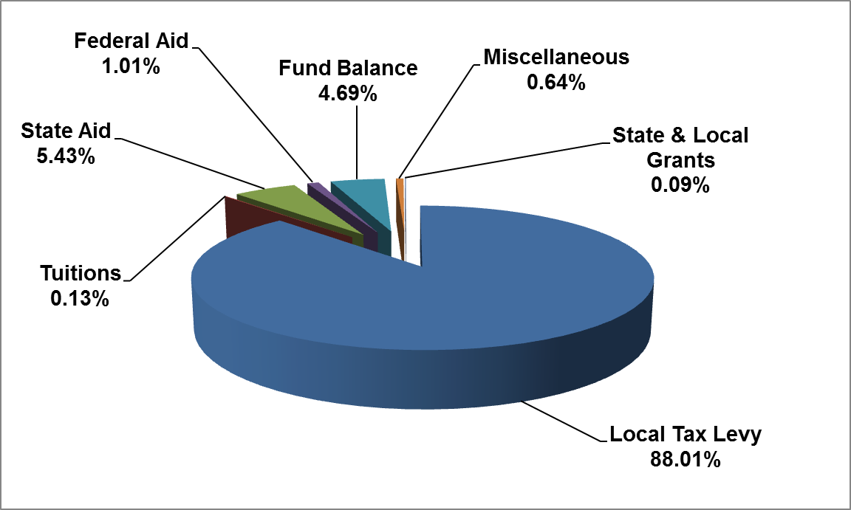
REVENUES
$85,402,262
Montgomery Township School District

Slide 3
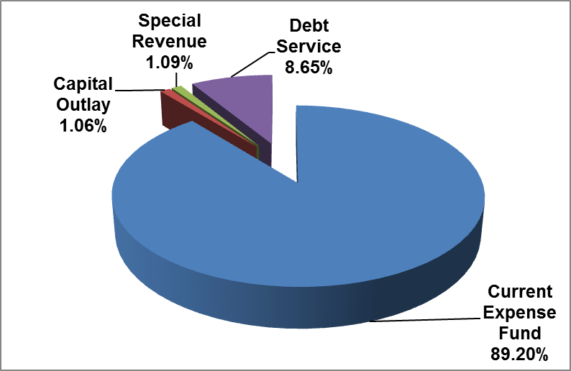
BUDGET
Current Expense $76,179,628
Capital Outlay 902,504
Special Revenue Fund* 935,032
Debt Service 7,385,098
Total Budget $85,402,262
*Fund 20 – Monies received for specific purposes (i.e. Grants)

Slide 4
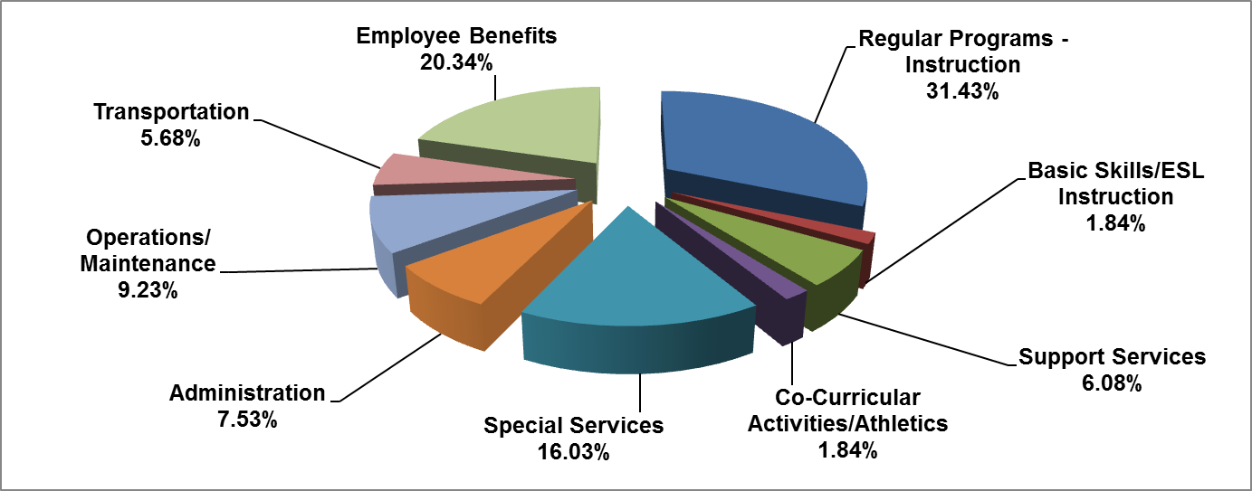
CURRENT EXPENSE BUDGET
$76,179,628
Montgomery Township School District

Slide 5
TAX IMPACT
Montgomery
Actual Assessments (+$600K)
Tax Rate +.032/per Hundred
Average Assessment $497,790 = +$161
Rocky Hill
Actual Assessments (+$447K)
Tax Rate +.051/per Hundred
Average Assessment $406,630 = +$209
Montgomery Township School District

Slide 6
QUESTIONS
Montgomery Township School District

